Slide 1



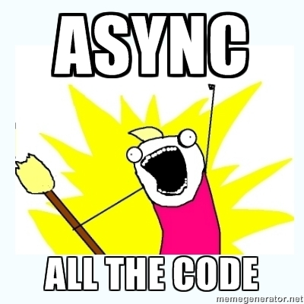
AJAX with ASP.NET MVC
ASP.NET MVC
Telerik Software Academy
http://academy.telerik.com

Slide 2

Table of Contents
What is AJAX?
Unobtrusive JavaScript
AJAX MVC Helpers
ActionLink
BeginForm
AJAX MVC PartialView rendering
Error handling
Beyond the Built-in Helpers
JSON and MVC

Slide 3

AJAX

Slide 4
What is AJAX
AJAX - Asynchronous JavaScript and XML
Receive from and send data to a server asynchronously (in the background)
AJAX is a combination of technologies
HTML and CSS for markup
DOM for display & interaction
XMLHttpRequest for async communication
JS for tying it all together

Slide 5
The XMLHttpRequest object
Raw AJAX
Used to send HTTP or HTTPS requests directly to a web server
The data might be received from the server as JSON, XML, HTML, or as plain text.
Requests will only succeed if they are made to the same server that served the original web page

Slide 6
Raw AJAX
Raw AJAX
function getServerTime() {
var xhr = newXMLHttpRequest();
xhr.open("GET", "/Home/ServerTime", true);
xhr.onreadystatechange = function() {
if(xhr.readyState == 4) {
if(xhr.status == "200") {
var timeDiv=
document.getElementById("timeDisplay");
timeDiv.innerHTML= xhr.responseText;
}
}
}
xhr.send();
}

Slide 7

AJAX Pitfalls
Increased load on the web server
Harder to debug
Harder to test
No back button
No support for Non-Ajax clients

Slide 8

Unobtrusive JavaScript

Slide 9
Unobtrusive JavaScript
No script injected into page
Only data-attributes with necessary AJAX settings
Requires unobtrusive extensions script
jquery.unobtrusive-ajax.js (AJAX helpers)
<a data-ajax="true“
data-ajax-method="GET"
data-ajax-mode="replace“
data-ajax-update="#latestReview"
href="/Home/LatestReview">
Click here to see the latest review</a>

Slide 10
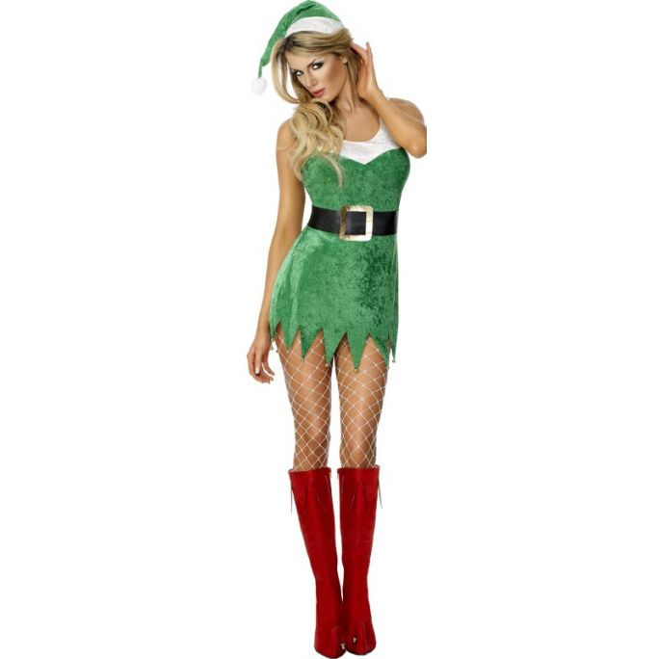
AJAX Helpers in ASP.NET MVC

Slide 11
AjaxOptions Object
Contains:
HttpMethod – Request method
InsertionMode – What to do with received data
UpdateTargetId – Element to update
LoadingElementId – Show progress
Url – URL to send data
Confirm – comfirmation message
Events – OnSuccess, OnFailure, OnBegin, OnComplete

Slide 12
Ajax.ActionLink Helper
Defines an action link for getting data
Makes an AJAX request
Based on options – does fancy things!
@Ajax.ActionLink("Вижте още", "GetBookFullContent", null,
new AjaxOptions
{
UpdateTargetId = "book-content",
LoadingElementId = "loading",
HttpMethod = "GET",
InsertionMode = InsertionMode.Replace,
OnSuccess = "completeAjax",
OnFailure = "errorAjax"
}, new { @class= "ajax-link" })

Slide 13
Ajax.ActionLink
Live Demo

Slide 14
Ajax.BeginForm Helper
Defines an form for sending data
Makes an AJAX request
Based on options – does fancy things!
@using (Ajax.BeginForm("Search",
new AjaxOptions
{ InsertionMode = InsertionMode.Replace,
UpdateTargetId = "book-details",
}))
{
<input type="text" name="query" />
<input type="submit" value="Search" />
}

Slide 15
Ajax.BeginForm
Live Demo

Slide 16

AJAX With PartialView

Slide 17
AJAX With PartialView
Return a PartialView to the helpers
Can be done through the original action
public ActionResult BookDetails(int? id)
{
if (Request.IsAjaxRequest())
{
var currentBook = …
return PartialView("_BookDetail", currentBook);
}
var model = …
return View(model);
}

Slide 18
AJAX With PartialView
Live Demo

Slide 19
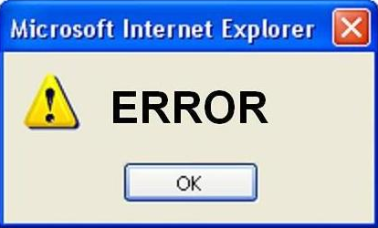
Error Handling

Slide 20
Error Handling
Default behavior is to fail silently
Override default by specifying OnFailure
Or handle error server side
public ActionResult Search(string query)
{
var result = …
if (result == null)
{
return Content("No results found");
}
return PartialView("_BookDetail", result);
}

Slide 21
Error Handling
Live Demo

Slide 22

Beyond The Helpers

Slide 23
Beyond The Helpers
Ajax Helpers cover simple scenarios
Replacing HTML content
Partial page rendering
Other scenarios require some JavaScript coding
Auto-complete textboxes
Client-side validation
Invoking JSON services and actions
Animations

Slide 24

JSON And MVC

Slide 25
JSON And MVC
Ajax Helpers cover simple scenarios
Replacing HTML content
Partial page rendering
Other scenarios require some JavaScript
Auto-complete textboxes
Client-side validation
Invoking JSON services and actions
Animations

Slide 26
JSON And MVC
Return JsonResult in the action
Use getJSON method from jQuery
public JsonResult Details()
{
var names = …
return Json(names);
}
$.getJSON("/Cars/Details", "", function(data) {
$(data).each(function() {
…
});
});

Slide 27
JSON And MVC
Live Demo

Slide 28
AJAX with ASP.NET MVC
http://academy.telerik.com

Slide 29
Homework
Create a database for storing information about Movies – Title, Director, Year, Leading Male Role, Leading Female Role and their Age, Studio, Studio Address.
Create Controllers and Actions for performing CRUD operations over the database.
Create an application that visualize and do operations with your data via Ajax.

Slide 30




Free Trainings @ Telerik Academy
“C# Programming @ Telerik Academy
csharpfundamentals.telerik.com
Telerik Software Academy
academy.telerik.com
Telerik Academy @ Facebook
facebook.com/TelerikAcademy
Telerik Software Academy Forums
forums.academy.telerik.com

